Slide 1
Programming Fundamentals
By
Shazmeen Batool

Slide 2
Task 01
Print the below patterns?
************
**********
*****
**
Xx
Xxxxxxxx
Xxxxxxxxxxxx

Slide 3
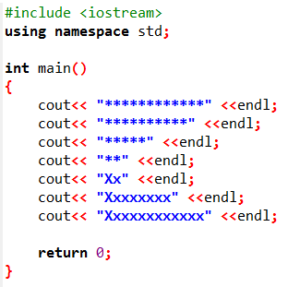
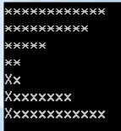
Solution

Slide 4
Task 02
Make your CV that includes your Name, Father’s Name, CNIC, Qualification, Semester, CGPA etc.? Print each line separately using “endl”. Use comments also.

Slide 5
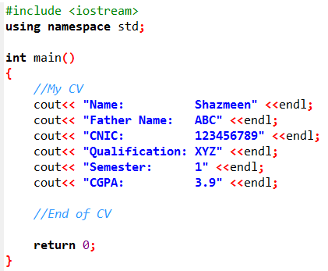
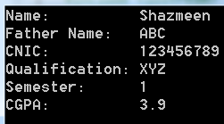
Solution

Slide 6
Task 03
As a small restaurant owner, you want a console-based program to print a basic menu for customers to view quickly at a counter. This avoids printing physical menus and saves paper in a real-world eco-friendly setup.
Requirements:
Use cout<< to output menu items with prices.
Use endl to separate items and sections (e.g., appetizers from mains).
Include comments (//) to label sections like "Appetizers" and "Main Courses," and explain any formatting.

Slide 7
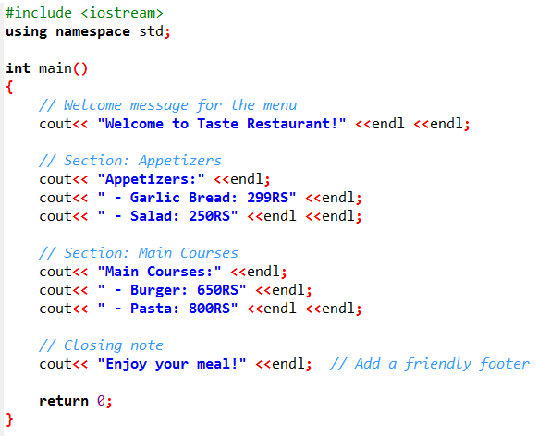
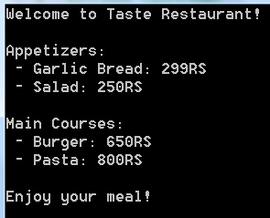
Solution

